Slide 1
Experience Zone 2 – OneDevOps
TITLE
Continuous Delivery Automation – Standardize, Automate & Reuse

Slide 2
OneDevOps – Introduction
PLACEHOLDER

Slide 3
OneDevOps – Framework
PLACEHOLDER

Slide 4





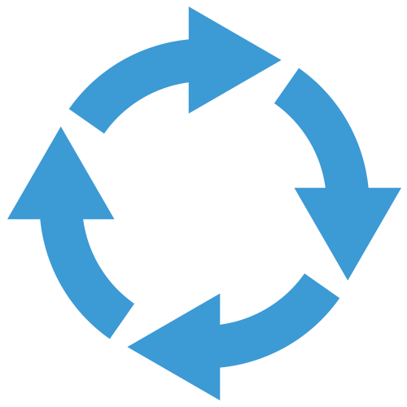




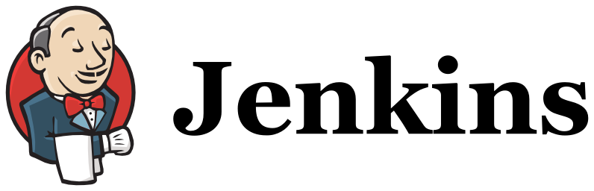
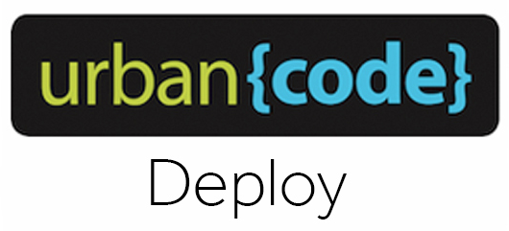



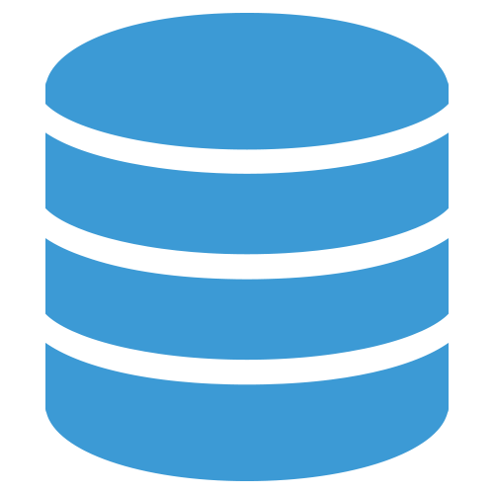
OneDevOps – CI & CD pipeline Automation
Dashboard
Increase Productivity & Improve Predictability
Story/Sprint creation
Automate build, execute and manage enterprise level CI/CD pipelines seamlessly.
Traceability Feed
Trigger CI
Code Check-In
Quality Gating Inputs
Code Quality & Coverage
Deployment Binaries with Traceability
Traceability Feed
Story/Sprint Branch Mgmt.
Artifact Download
CI/CD Pipeline
Environments
Standardized processes across portfolios & reusable templates
Automated Jobs
Standardize Process & Automate
Supports faster integration with various ALM/SCM toolsets
Dashboard
Automation Plug-ins
Template Repository
Best Practice embedded & Highly Scalable & Granular

Slide 5

Detailed Workflow
Pass Story ID and trigger Self service
Creates Feature Branch with Story ID
Create Story
Update Story with Build Results
Build Feature Branch
Get Latest from Feature Branch
Build & Package
Unit Test
CCAP Analysis
Quality gate
Auto Trigger - Every Commit
Creates Merge request
Merge Feature Branch
Promote Release Candidate
Merge Approved
Code Station
Execute CI Pipeline
Publish Binaries
Environments
Deployment Successful
Deploy Application
Smoke Test
Quality gate
Notes:
1. From SNOW ticket created for CR.
2. Syncs with MainSpring with a story ticket.
3. In MainSpring, the story status is changed to planned and attached to a release & sprint& story points.
4. Sync from MS to Jira with MS Story ID as the primary link in Jira ticket.
5. From Jira ticket, the workflow trigger is handed over to CloudSet. The self-service jobs will be created (1. build job for feature branch 2. Create Merge job 3.Publish Job from release branch to uDeploy).
6. Automation Starts - CloudSet -> Gitlab branch creation (from master to 1. Release branch & 2. Feature branch)
7. Show code check-in gitlab with a commit hook which will sync with jira.
8. Build pipeline for FB will be triggered in CS. (usual automation & QG till sonar)
9. Trigger "Create GitLab merge request" job in CloudSet, when feature build is complete.
10. Go to GitLab, review changes & approve merge to release/sprint branch.
11. Once approved, the release or publish jobs will start & build, quality gate from the release branch, and move the release binary to uDeploy & hand over control to uDeploy.
a. uDeploy process to deploy the binary with simulated selenium smoke, and environment approval to sign-off deployment.
b. uDeploy process to deploy the binary with simulated selenium smoke & rollback if QG fails.
12. Show the tractability of the build jobs back in jira & mainspring. Also, mention that if sprint level handle is available from mainspring, uDeploy can post the deployment statistics.

